Slide 1

Sales Data Analyst Case Study Submission for Clipboard Health
Created by Craig Scarboro

Slide 2
Purpose
At Clipboard Health, we seek match care facilities with talented staff to make sure that all patient needs are taken care of. Today, we are going to be looking at the where, when, and who of staffing needs within our partner facilities.

Slide 3
Methodology
Data from the centers for Medicare and Medicaid services was pulled and used to perform data analysis. This data is available to the public and contains information regarding location of care facilities and the hours worked by both employee and contractor caretakers during the first quarter of 2024. The data can be found here.
The data analysis was performed using Jupyter Notebooks because of the robust and powerful nature of Python as a data analysis tool. Alongside this Powerpoint, I have also included a PDF copy of the original analysis that includes my rationale for taking the steps that I did.

Slide 4
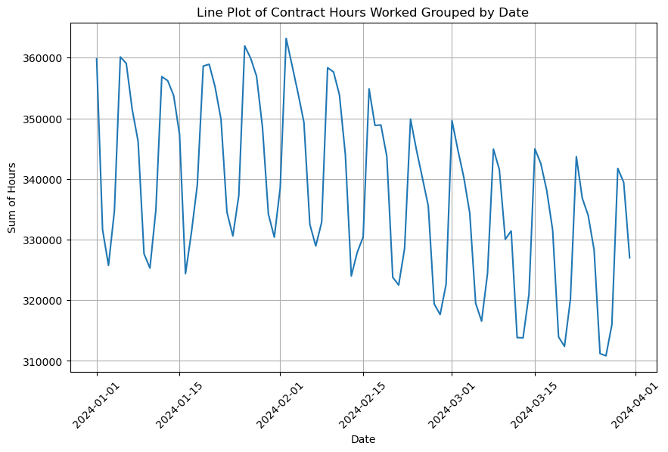
When are contractors needed
We can discern from the data that the total hours worked by contractors follows a cycle through each month in Q1 2024.
Each month has between 4 and 5 spikes in hours worked.
I recommend that we work to identify what is causing these spikes in need for contract hours so that we can time our staffing in accordance with the need of the care facilities
This would help to optimize our business strategy to make sure that we are always staffing an appropriate number of caretakers.

Slide 5
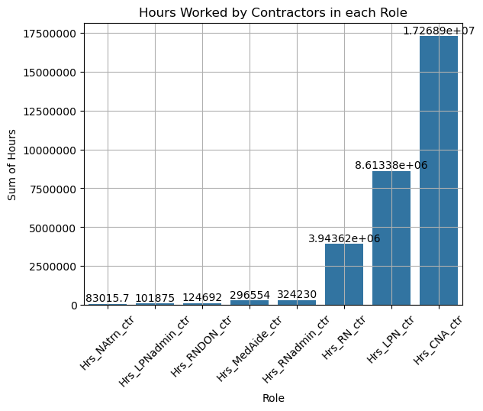
What types of contractors are needed
We observe that the most in demand roles for contractors, based on reported hours worked in the time frame, are CNAs, LPN, and RNs in descending order.
Notably, CAN contractors have roughly double the number of reported hours compared to the next highest role.
I recommend we put most of our time and energy into staffing these roles due to demand, we a special focus on the CNAs.

Slide 6

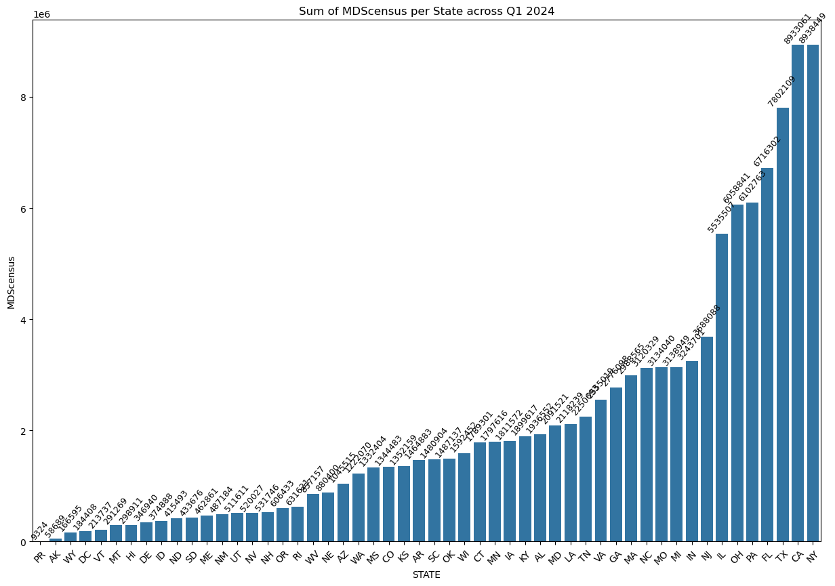
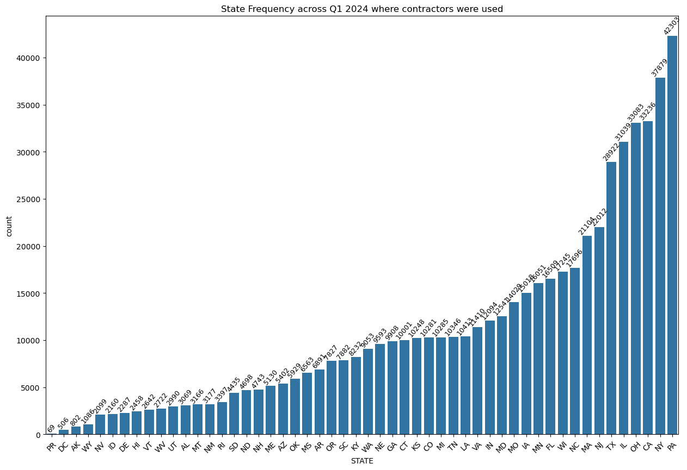
Where contractors are needed
We observe that the states with the highest total sum of patients reported under MDScensus are NY, CA, TX, FL, PA, and OH.
Going further we find that the states that appear the most frequently in reporting that utilize contractors are NY, CA, TX, PA, and OH
Based on this, we should focus on contractor placement in the overlap of these finding, being NY, CA, TX, PA, and OH as it is implied that these states show a high patient count and a high utilization of contractor caretakers

Slide 7
Conclusion
From the analysis I performed, I recommend the following:
We focus on identifying the points in each month where the need for contract caretakers will be the highest
We work to provide the most in-demand types of workers the long-term care facilities need to operate
We look at the states that show the highest need and usage of contractors to increase the number of workers that we can place everyday.
Thank you very much for your time and attention. I look forward to hearing back with the next steps.

